Slide 1
DES Algorithm
Code Overview
Yasir Yakup Demircan #204306001

Slide 2
Arrays and Materials

Slide 3
Initial Permutation and Permuted Choice Arrays
//Permuted choice 1 Array
var PC1L = [57, 49, 41, 33, 25, 17, 9, 1, 58, 50, 42, 34, 26, 18, 10, 2, 59, 51, 43, 35, 27, 19, 11, 3, 60, 52, 44, 36];
var PC1R = [63, 55, 47, 39, 31, 23, 15, 7, 62, 54, 46, 38, 30, 22, 14, 6, 61, 53, 45, 37, 29, 21, 13, 5, 28, 20, 12, 4];
//Permuted choice 2 Array
var PC2 = [14, 17, 11, 24, 1, 5, 3, 28, 15, 6, 21, 10, 23, 19, 12, 4, 26, 8, 16, 7, 27, 20, 13, 2, 41, 52, 31, 37, 47, 55, 30, 40, 51, 45, 33, 48, 44, 49, 39, 56, 34, 53, 46, 42, 50, 36, 29, 32];
//Initial Permutation Array
var IP = [58, 50, 42, 34, 26, 18, 10, 2, 60, 52, 44, 36, 28, 20, 12, 4, 62, 54, 46, 38, 30, 22, 14, 6, 64, 56, 48, 40, 32, 24, 16, 8, 57, 49, 41, 33, 25, 17, 9, 1, 59, 51, 43, 35, 27, 19, 11, 3, 61, 53, 45, 37, 29, 21, 13, 5, 63, 55, 47, 39, 31, 23, 15, 7];

Slide 4
Inverse Initial Permutation,Expansion Permutation and Permutation Arrays
//Final permutation IP inverse
var IPinv = [40, 8, 48, 16, 56, 24, 64, 32, 39, 7, 47, 15, 55, 23, 63, 31, 38, 6, 46, 14, 54, 22, 62, 30, 37, 5, 45, 13, 53, 21, 61, 29, 36, 4, 44, 12, 52, 20, 60, 28, 35, 3, 43, 11, 51, 19, 59, 27, 34, 2, 42, 10, 50, 18, 58, 26, 33, 1, 41, 9, 49, 17, 57, 25];
//Expansion permutation Array
var EP = [32, 1, 2, 3, 4, 5, 4, 5, 6, 7, 8, 9, 8, 9, 10, 11, 12, 13, 12, 13, 14, 15, 16, 17, 16, 17, 18, 19, 20, 21, 20, 21, 22, 23, 24, 25, 24, 25, 26, 27, 28, 29, 28, 29, 30, 31, 32, 1];
//32 bit permutation after sBox
var P = [16, 7, 20, 21, 29, 12, 28, 17, 1, 15, 23, 26, 5, 18, 31, 10, 2, 8, 24, 14, 32, 27, 3, 9, 19, 13, 30, 6, 22, 11, 4, 25];

Slide 5
SBOXES
var sBoxes={
1:{
0:[14,4,13,1,2,15,11,8,3,10,6,12,5,9,0,7],
1:[0,15,7,4,14,2,13,1,10,6,12,11,9,5,3,8],
2:[4,1,14,8,13,6,2,11,15,12,9,7,3,10,5,0],
3:[15,12,8,2,4,9,1,7,5,11,3,14,10,0,6,13]
},
2:{
0:[15,1,8,14,6,11,3,4,9,7,2,13,12,0,5,10],
1:[3,13,4,7,15,2,8,14,12,0,1,10,6,9,11,5],
2:[0,14,7,11,10,4,13,1,5,8,12,6,9,3,2,15],
3:[13,8,10,1,3,15,4,2,11,6,7,12,0,5,14,9]
}, …(6 more boxes)

Slide 6
Key Creation

Slide 7
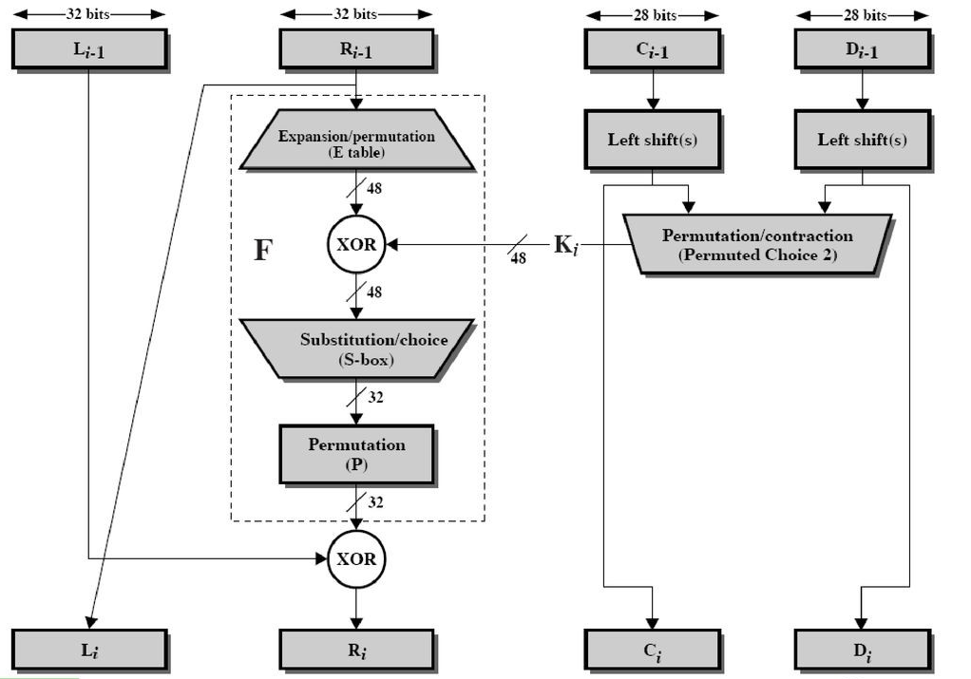
Initial Permutation / Splitting Key Parts
//Initial permutation for left/right key parts
function initPermKey() {
PC1L.forEach(function (perm) {
K56L += K64[perm - 1]; //Convert char count to index
});
PC1R.forEach(function (perm2) {
K56R += K64[perm2 - 1]; //Convert char count to index
})
}

Slide 8
Left shifts for key rounds
//Shift counts for key rounds
var roundShifts = [1, 1, 2, 2, 2, 2, 2, 2, 1, 2, 2, 2, 2, 2, 2, 1];
function leftShift(C, D, amount) {
let resC = "";
let resD = "";
if (amount == 1) {
for (let i = 1; i < C.length; i++) {
resC += C[i];
}
resC += C[0];
for (let j = 1; j < D.length; j++) {
resD += D[j];
}
resD += D[0];
} else ...

Slide 9
Applying PC2 to keys
// Applying PC2 to keys
function finalizeKeys() {
let returnKey = "";
allKeys56.forEach(function (key, index) {
PC2.forEach(function (perm) {
let CD = key.C + key.D;
returnKey += CD[perm - 1];
})
allKeys48[index] = returnKey;
returnKey = "";
});
}

Slide 10
Message Preparation &
Encryption

Slide 11
Applying IP to the message (ML/MR binary L/R message parts)
//Apply Initial Perm to message
function initPermMsg() {
ML2 = "";
MR2 = "";
let fullMsg = ML + MR;
IP.forEach(function (perm, index) {
if (index < 32) {
ML2 += fullMsg[perm - 1]
} else {
MR2 += fullMsg[perm - 1]
}
});
}

Slide 12
Applying Expansion/Permutation to the message
//Expansion permutation for the message
function expandPermMsg(msg) {
let result = "";
EP.forEach(function (perm) {
result += msg[perm - 1]
})
return result
}

Slide 13
Message XOR round key
//Simple exclusive or implementation
function XOR(a, b) {
let result = "";
for (let i = 0; i < a.length; i++) {
if (a[i] == b[i]) {
result += "0"
} else {
result += "1"
}
}
return result
}
//Expand message part to 48 and XOR with key
let msg48 = expandPermMsg(msg);
let resXOR = XOR(msg48, key);

Slide 14
Split message into 6 bits and substitute using SBOX
let resXOR8 = [];
let afterBox = [];
let stringAfterBox = "";
//Cutting into 8 pieces for Sboxes
for (let i = 0; i < resXOR.length; i = i + 6) {
resXOR8.push(resXOR.slice(i, i + 6));
}
//Apply sBoxes
resXOR8.forEach(function (sixbit, index) {
let MSBLSB = parseInt(sixbit[0] + sixbit[5], 2);
let midbits = parseInt(sixbit[1] + sixbit[2] + sixbit[3] + sixbit[4], 2);
afterBox.push(sBoxes[index + 1][MSBLSB][midbits]);
});

Slide 15
Apply permutation after SBOX substitution
function Permutation32(msg) {
let result = "";
P.forEach(function (perm) {
result += msg[perm - 1]
});
return result
}
Permutation32(stringAfterBox);

Slide 16
Feistel structure operation and XOR for every
round (IP inverse after last round)
let Rcopy;
allKeys48.forEach(function (key, index) {
Rcopy = R;
// Not using key0
if (index != 0) {
Rcopy = R;
R = XOR(L, processMsgPart(R, key))
L = Rcopy;
}
});
//Reversing the 32bit blocks for final permutation IP inverse
afterENC = R + L;
result = finalPermutation(afterENC);
return result;

Slide 17
Decryption

Slide 18
Encryption with reverse key order = Decryption
let Rcopy;
for (let i = 16; i > 0; i--) {
Rcopy = R;
R = XOR(L, processMsgPart(R, allKeys48[i]))
L = Rcopy;
}
//Reversing the 32bit blocks for final permutation IP-1
afterDEC = R + L;
result = finalPermutation(afterDEC);
return result;

